Slide 2
b-Histoplasmosis
c. Coccidioidomycosis
d. Paracoccidioidomycosis
5. Opportunistic mycoses Patients or individuals with immune deficiency are easily suffering from opportunistic mycoses caused by fungi belonging to normal flora.
Candidiasis

Slide 3
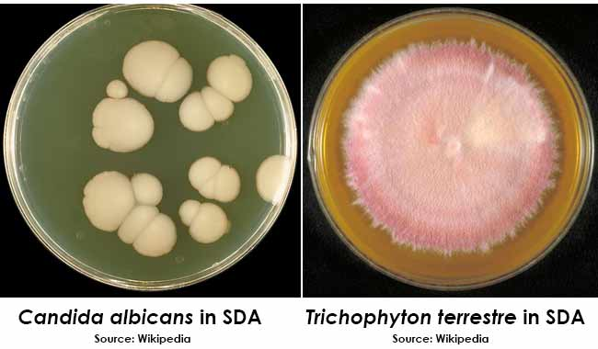

Slide 4

Aspergillosis

